Slide 1
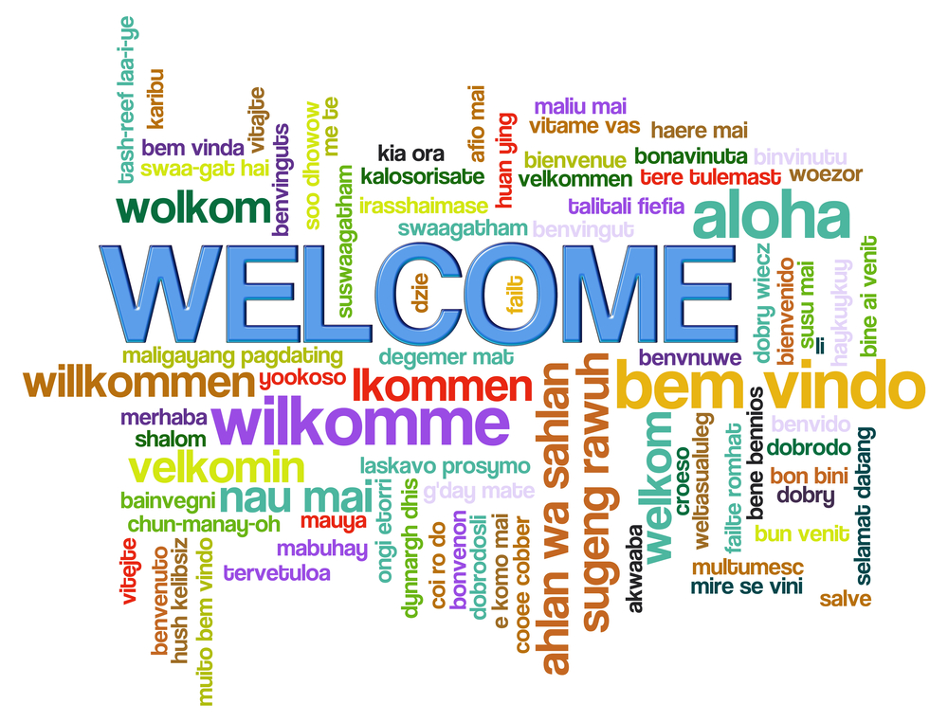

Slide 2
Introductions
Notes:
Lani

Slide 3
What Is Domestic Violence?
Domestic violence is the willful intimidation, physical assault, battery, sexual assault, and/or other abusive behavior that is part of a systematic pattern of power and control perpetrated by one intimate partner against another.
It may involve coercion, manipulation, lying, threats of physical harm, physical violence, verbal abuse, threats and other forms of creating fear and controlling a victim.

Slide 4
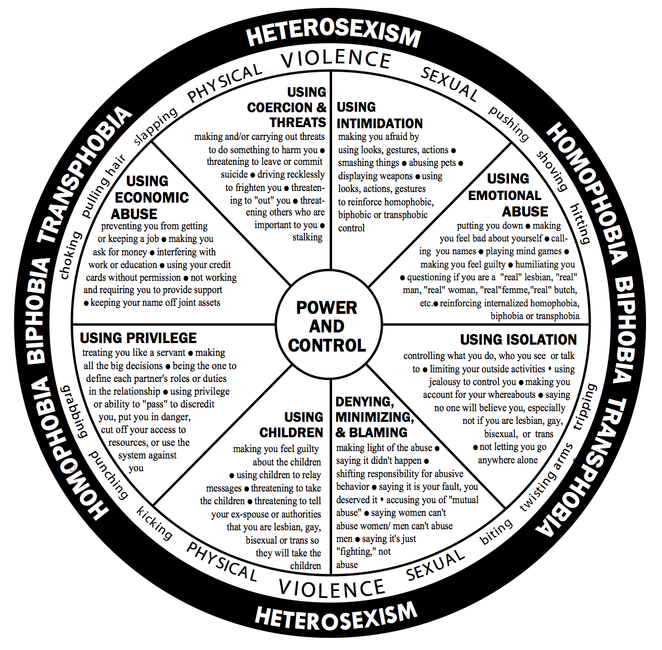
The Power and Control Wheel
Using intimidation
Using emotional abuse
Using isolation
Minimizing, denying, and blaming
Using children
Using male privilege
Using economic abuse
Using coercion and threats
Using Technology to abuse - sending threatening emails, posting negative messages on social media,
Stalking - installing GPS devises to stalks their victims, etc..
Notes:
Use terms of women/she when talking about domestic violence victims --- majority of DV is men perpetrate violence against female partner --- also men perpetrate against male partners, women who perpetrate against both male and female partners. Also recognize the are victims who do not identify as male or female --- gender neutral.
Domestic violence is not just physical hitting ---- system of power and control within a relationship…where violence and threats of violence are used to gain and maintain control.
Power and control wheel – developed by women who were in groups at the Domestic Abuse Intervention Project in Duluth ---- Looking at “Cycles of Violence” and saying that did not fit their reality. Described what they experienced and wheel was created.
94% of murder-suicide victims are female.
76% of intimate partner physical violence victims are female; 24% are male.
More than 75% of women aged 18-49 who are abused were previously abused by the same perpetrator.
76% of women who are killed by intimate partners and 85% of women who survive homicide attempts are stalked prior to the murder or attempted murder.
Domestic violence happens in same sex relationships at about the same rate as in heterosexual relationships. The National Coalition of Anti-Violence programs conducted a 1O-year study in 10 U.S. cities which documented domestic violence at a rate between 25-33% in same sex relationships. A 1991 study found that 46% of the women responding had experienced 2 or more incidents of physical violence in their relationship.
Lesbian battering includes many of the same issues as heterosexual domestic violence (power and control), fear, lack of safety) but is additionally affected by homophobia and a lack of services for victims of lesbian violence.

Slide 5
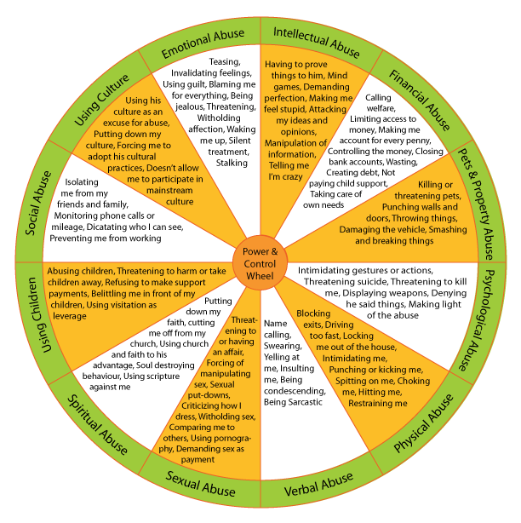
Notes:
Many adaptations of the Power and Control Wheel.

Slide 8
DeafHope – Power and Control Wheel Cont.
Intimidation:
Uses ASL to make you afraid with gestures, facial expressions, or exaggerated signs, then
uses Deaf culture to justify the behavior
Overuses floor stomping and pounding on the table or door
Signs very close to your face when angry
Gets angry because you look away while he is talking
Emotional Abuse:
Criticizes your speech, ASL or English skills
Calls you “hearing-mind” because you aren’t fluent enough in ASL or don’t socialize or
identify with the Deaf community
Makes fun of your ASL style
Puts down your education background, public school or residential school
Tells you that you are too sensitive "like hearing people”
Isolation:
Checks your pager, instant messenger, videophone, e-mail and/or TTY conversations
Moves away from the Deaf community and/or your family to isolate you
Tells you no one will believe you, because he is too well-known in the Deaf community
Takes advantage of the lack of accessible services for Deaf survivors
Minimizing, Denying & Blaming:
Denies abuse by saying it accepted in Deaf culture
Angrily throws things at you as a way to get attention
Tells people private things (example: "My wife is lousy in bed."), and says it is okay to share private information because it is part of Deaf Culture
Using Children:
Your partner is hearing and doesn’t allow your children to use ASL to talk with you
Doesn't allow your children to be proud of Deaf culture
Criticizes you as a Deaf mother, says bad things about you to your children
Tells you and the children that you cannot go to a shelter because everyone is hearing
Hearing Privilege:
Excludes you from important conversations (talking to the bank without you knowing)
Leaves you out in social situations (such as a party or dinner) with hearing people
Talks negatively about the Deaf community
If you call the police, he interprets to manipulate the situation to his benefit
Economic Abuse:
Takes away your SSI checks or making you lose it by reporting additional income
Ruins your chances for a job by spreading rumors about you in the small Deaf community
Demands you ask for permission before spending money
Coercion and Threats:
Destroys your reputation by spreading false rumors
Uses his power in the Deaf community to pressure you to stay
Uses the Deaf school as the reason to stay together to support your Deaf children
Uses his position as a leader in the Deaf community to discredit your story

Slide 12
How to Use the Power & Control Wheel
To help a woman who is being battered reframe her and her children’s experience
To better understand the cultural context of a battered women’s experience
Training for staff and volunteers
Public education/public awareness
Support and education groups
Notes:
Facilitator: Liz

Slide 13
Pillars of Oppression – Praxis International
Oppressors (abusers) base their actions on a belief in their superiority.
Social institutions and culture may be modified or constructed to support this notion—e.g. Nazi rule, European colonization of tribes and indigenous peoples, and slavery. There is always a philosophy that underpins oppression.

Slide 14
Pillars of Oppression – Praxis International
Oppressors make the oppressed into inferior objects that they believe do not deserve equal treatment.
The oppressed are made into subhuman entities that are very unlike the oppressors. For example, white colonizers believe that American Indian/Alaska Native and people of color are not like them—do not share the same emotions, intellect, or bodies. Women are objectified through pornography. Gay people are objectified by homophobia.

Slide 15
Pillars of Oppression – Praxis International
Oppressors teach submission to the oppressed through day-to-day disdain, messages of inferiority, and overt violence.
Consequently, the oppressed groups end up internalizing the way oppressors characterize them. The most insidious result of oppression is that it changes the self-perception of the oppressed.

Slide 16
Pillars of Oppression – Praxis International
Oppressors are able to use violence against the oppressed with impunity.
Social institutions support this impunity and oppressors are relieved of accountability for their violence.

Slide 17
Pillars of Oppression – Praxis International
Oppressors effectively control the oppressed by splitting them into good (collaborators) and bad (resistors)…. classic divide and conquer technique
This divisiveness thwarts the possibility of a united resistance movement. This is the true and tested divide-and-conquer rule.

Slide 18
Pillars of Oppression – Praxis International
These mechanisms are essential in maintaining systems of domination. Violence, which is a tool to perpetrate and perpetuate oppression, is used to maintain the status quo. It plays a significant role in all oppressive relationships.

Slide 19
Role of an Advocate
Notes:
Facilitator: Erika, Liz and Sipra

Slide 20
An advocate for victims/survivors of gender-based violence plays an integral role in supporting victims/survivors and connecting them with services that may increase their safety and healing. Studies have shown that the sooner a victim/survivor connects with an advocate after an assault, the likelier they are to seek services in the future. Although as an advocate you want to see the victim/survivor safe, that is out of your control and it is not your role. You need to support the victim/survivor where they are at, without judgement and without trying to influence their decisions and actions. Your goal as an advocate is to provide support, validation, options and resources in a patient, respectful and ethical manner.

Slide 21
Remember, you cannot save someone.
You can provide information, options, a listening ear, and support, but ultimately, they will save themselves, or “choose” to stay in the relationship
Many women are pushed back into a violent relationship because of financial hardship, no childcare, kids are pressuring her to go back to their dad who they miss, family members deny them support or criticize them for leaving, religious pressures, homelessness, and/or believing the abuser is truly sorry and it will not happen again. For immigrants/refugees, the abuser may be the only person in their community who shares a history of their life before leaving their home, someone who deeply knows them with shared memories and experiences.

Slide 22
Believe Them
It is not the job of the advocate to decide whether or not what they are being told is true or credible. It is extremely difficult to come forward and ask for help, and the overwhelming majority of victims/survivor will never tell anyone.

Slide 23
Listen to Them
Victims/survivors often tell their stories in a non-linear manner. An advocate is meant to listen, not interrogate, and reassure them that they did not deserve the maltreatment they experienced (no matter if they were drunk/ high/ yelling/ unfaithful/etc).

Slide 24
Not Their Fault
Reassure them that the violence they experienced was 100% the responsibility of the offender (i.e. they get stressed or anger at work but don’t beat up their boss, they CAN control their emotions and reactions, they just choose not to with their victim).

Slide 25
Did Not Deserve the Abuse
Reinforce to that they did not deserve to be abused, again – no matter what the circumstances were.

Slide 26
Ask Them
Ask them
what they would like to do,
what they would like to see happen and
what they need right now.

Slide 27
Victim is the Expert
Understand that the victim is the expert on their own safety. Some offenders will avoid contact with law enforcement at all costs and getting and Order for Protection will help their victim. Others will escalate the violence if their victim gets and Order for Protection.

Slide 28
Provide information Do NOT Influence
Provide information and options WITHOUT influencing the victims/survivors decisions. Abusers try to control their victims, make decisions for them, manipulate them choosing what the abuser wants to see happen…..we do not want to replace the abuser. We give all legal options and information without trying to sway the victims decision even if we do not agree with her decision.

Slide 29
Let Them Know
Tell the victim/survivor that you will support whatever decision they make (obviously other than violence against the offender or their property or doing harm to themselves) and that they can change their decisions as they see fit and you will still continue to support them.

Slide 30
Non-judgemental
Tell them that it is their decision to make and you will not judge them for any decisions they make, including staying with their abuser.

Slide 31
Maintain Confidentiality
Do not betray confidentiality. Only share information about a specific case with someone internally on a need to know basis. Unless the victim/survivor has signed a release of information, no information about the client should be shared with anyone outside of the agency. No one should know that the client is seeking services as this may endanger them further.

Slide 32
Minimize Trauma
Minimize the number of times a victim/survivor has to tell their story as this is revictimizing and compounds their trauma.

Slide 33
Safety Planning
Conduct safety planning with the initial call and check-in on safety plans on consecutive interactions.

Slide 34
Leaving the Relationship
Understand that on average it takes seven (7) times of leaving and returning to an abusive relationship before a victim/survivor leaves for good. Many victims/survivors do not leave the relationship … they still deserve support and advocacy without judgement.

Slide 35
Power & Control
Domestic violence and sexual assault are about Power and Control. When a victim/survivor is taking the steps to leave a violent relationship they are at increased risk of lethality. They are at the highest risk when their abuser feels that they are losing or have lost control over them, i.e. divorce, lost custody of children, etc. Most women who are killed by their abusers have been out of the relationship for at least a year.

Slide 36
Warm Referrals
If you are going to refer a client to another agency for services, make it a “warm referral”. If possible, and with the client’s permission, call the agency on behalf of the victim and give them some background on the victim and what services they are seeking; set up an appointment that works with the victim’s schedule and make sure that transportation and/or interpreting services are in place. Fax over a release of information if the client wants them to share information with you on their services/case.

Slide 37
Praxis International Social Change Advocacy – Core Principals
Create an experience that is liberating...
Create an experience that is liberating and counter to her
experience of abuse, violence, and oppression.
...vs. dominating
Creating an experience that is oppressive—i.e., based on a relationship of dominance.
Examples may include mandating services, compelling compliance,
and being overly focused on rules.

Slide 38
Praxis International Social Change Advocacy – Core Principals
Engage in dialogue...
Engage in a mutual dialogue that allows both the advocate and the
woman/survivor to learn, grow, and develop new knowledge and insights.
...vs. counsel or advise
Treating a woman/survivor as a “data point” to get
specific information that meets the agency’s needs—i.e., “to fill out the form,” or
to relay or list information about what this or another agency requires or provides.

Slide 39
Praxis International Social Change Advocacy – Core Principals
Recognize intersection and complexity...
Recognize the multiple layers in women/survivor’s lives, created by factors such as economics, identity, life experience (including her experience of institutions), values and beliefs, culture, social status, factors of resistance and resilience. No one aspect is entirely separate; each informs and shapes the others.
...vs. single aspects or events
Working on a single aspect of a woman/survivor’s situation outside of the
context of the others—e.g., economics, identity, life experience
(including her experience of institutions), values and beliefs,
social status, factors of resistance and resilience.

Slide 40
Praxis International Social Change Advocacy – Core Principals
Place the person’s reality and actual needs at the center...
Focus on making the full reality of her circumstances and situation visible and
understood. Institutions create a version of her reality that may or may not be accurate. Attempt to match what the institution does with what the woman/survivor needs and make the institutional response better fit her needs. Fully explore the actual costs and benefits of any course of action.
...vs. those of institutions
Processing the case not based on the actual woman/survivor’s experience or the complex,
multiple effects of institutional actions, but on institutional case management
needs and goals, such as obtaining convictions, investigating cases,
completing a medical exam, and administering assessment tools.
Standardized responses that may or may not fit her needs.

Slide 41
Praxis International Social Change Advocacy – Core Principals
Engage with social networks, family, and community...
Build from, involve, and expand women’s connections, rather than seeing women as isolated individuals.
...vs. isolated individuals
Working with women (or women and their dependent children) in isolation,
without connecting to existing social networks such as members of her
immediate and extended family, friends, and community.

Slide 42
Praxis International Social Change Advocacy – Core Principals
Approach as a social problem...
Approach the situation with the understanding that it arises from a social problem, as opposed to one that is caused by the actions of individuals or the state of an individual’s psyche. Oppression debilitates people in many ways; it is supposed to. Individuals’ strategies of coping and resistance are not the cause of the problem,
but a response to it. There is no “functional” way to respond to oppression.
...vs. individual or psychological
Framing the situation as the outcome of individual choices, actions, frailties, or shortcomings.
Emphasize shoring up what are seen as the individual’s shortcomings. Focus on the
individual needing to change or better manage the situation.

Slide 43
Levels of Advocacy

Slide 44
3
Levels
Of Advocacy
Individual, institution, and community

Slide 45
Distinct but Interconnected Levels of Advocacy
Individual: helping one woman at a time
Institutional (systems) advocacy: seeking change on behalf of all women/survivors as a group
Community advocacy: on behalf of all women/survivors, change the social-cultural conditions

Slide 46
Individual
Institutional
Community
3 Levels of Advocacy
Assaulted, wants abuser arrested.
Community distrust of
police
Mutual arrest.

Slide 47
Washing Machine Story
https://youtu.be/0obk_Y03APo
Notes:
Youtube Link: https://youtu.be/0obk_Y03APo

